Slide 1
Big Data Technology
Paul Rad, Ph.D.
Associate Professor
Information Systems and Cyber Security, College of Business School
Electrical and Computer Engineering, College of Engineering

Slide 2
Outline
Logistics
Summary and Review Previous Sections
Working with TensorFlow on Cloud
Sample Programs

Slide 3
Two important steps
Step 1 : Build a computation graph
graph:
Declare Variables
Build Models
Create nodes for visualizing with
TensorBoard
Step 2 : Run the graph
Session:
Execute the graph declared above
Collect results and
Visualize results on Tensorboard

Slide 4
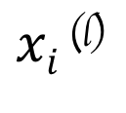
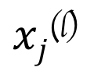
Machine Learning Model
Unknown Target Function
f: X → Y
Training
Data Set
Test
Data Set
Regression
Model
$xi$^{(l)}
$xj$^{(l)}
Hypothesis

Slide 5


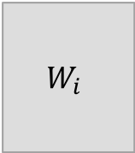
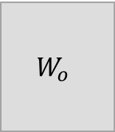

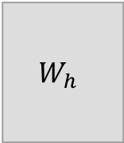
Neural Network
$$W_{i}$$
$$B_{i}$$
$$W_{h}$$
$$B_{h}$$
$$W_{o}$$
$$B_{o}$$
Training data
Predicted data
Loss
Stochastic Gradient Descent
Actual data
3 Layer Neural Network

Slide 6
Assessing Performance

Slide 7
Bias and Variance
Training
Data Set
Test
Data Set
Human Level Error = 5%
Training Error = 30%
Test Error = 33%
Human Level Error = 5%
Training Error = 7%
Test Error = 30%
What to do next ????
What to do next ????
“Over fitting problem”
Bigger Model
Training Longer or Use GPU (Faster Systems)
New Model architecture
More Data
Regularization
New Model architecture

Slide 8
Neural Network
$$W_{i}$$
$$B_{i}$$
Predicted data
Training data
Loss
Gradient Descent
Actual data
1 Layer Neural Network

Slide 9
MNIST Number Detection Problem
h(x)
1
θ
28 X 28 = 784
e
θ
x1
θ
x2
θ
x
θ
784

